Slide 1
Intel VTune™ Amplifier –
Platform Profiler

Slide 2
Updates in VPP 2019 release
Added support for Cascade Lake and Coffee Lake platforms
Removed dependency on Java
Added support for IPMWatch 2.0 –Windows and AEPWatch 1.1.1 on Linux
Added support for Python 3 in VPP collector
Configurable port for VPP server
Added two new metric (core view)
    TMAM FP Scalar
    TMAM FP vector
Added dataset upload progress indicator in GUI

Slide 3
Agenda
Introduction & Goal
  Performance Tools and their usage
A taste of Intel® VTune™ Amplifier’s Platform Profiler (aka VPP)
Using VPP
Collecting and Uploading Data
Navigating Results

Slide 4
Goal of today’s meeting
Intel VTune™ Amplifier’s Platform Profiler is bundled in VTune Amplifier 2019
At the end of this meeting, participants will be able to
  Understand the tool’s positioning and how it complements VTune
  Understand the type of customers that can benefit from the tool
  Understand the tool’s features and workflow

Slide 5
The Long & Short of Performance Analysis
Get the big picture first with a Snapshot or Platform Profiler
 | Snapshot Quickly size potential performance gain. Run a test “during a coffee break”. | In-Depth Advanced collection & analysis. Insight for effective optimization.
Application Focus HPC App developer focus 1 app running during test | VTune Amplifier’s Application Performance Snapshot Metrics: • OpenMP • Vectorization • MPI • Memory • I/O | VTune Amplifier • Many profiles Intel Advisor • Vectorization ITAC • MPI Optimization
System Focus Deployed system focus Full system load test | VTune Amplifier’s Storage Performance Snapshot Metrics: • I/O • CPU • Memory • Network | VTune Amplifier - Sampling: • System wide EBS - Platform Profiler: Metrics: •~20 OS • ~150 hardware
S-M
S
S-L
L
S-M
L
L
Maximum collection times: L=long (hours) M=medium (minutes) S=short (seconds-few minutes)

Slide 6
Performance Optimization - Big picture first, then the details
Long data collections, light on detail
When & how is hardware underutilized?
Short data collections, lots of detail
Attribute to source, memory access patterns…
Intel® VTune™ Amplifier
Platform Profiler
  Plan a tuning strategy or monitor QA
    Analyze long runs
    Find times with low performance
    Use metrics to plan deeper analysis
      Low Floating Point → Optimize vectorization
      High memory ops → Analyze memory access
  Optimize hardware configuration
    Run a mix of your target workloads
      High processor utilization → more cores
      High memory use → more memory
      I/O limited → more or faster I/O
Intel® VTune™ Amplifier
  Cache optimization
  Load balancing
  Memory access analysis
  More…
Intel® Advisor
  Vectorization optimization
Intel® Trace Analyzer & Collector (ITAC)
  MPI optimization
Notes:
To optimize your next hardware configuration, run your target workloads and see where the system is limited. Do you have sufficient headroom for applications to evolve?
For example, PPE will return metrics on memory capacity for both the OS an the application. Are you near the limit or do you have headroom for growth? Same thing with I/O bandwidth – are you near the limit of I/O? What is the processor utilization? If it is high, you may want a system with more cores to give you room for growth.

Slide 7
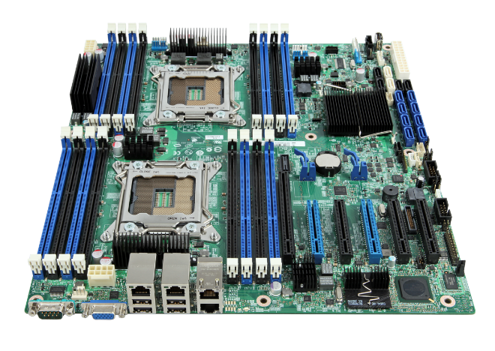
Platform Profiler
Intel® VTune Amplifier -
Preview
Target User
  Infrastructure Architects
  Software Architects & QA
  Infrastructure Maintainers
Performance metrics on system topology
  Display current configuration
  Socket → Core → Internal Caches
  Socket → Memory Link → Memory Module
Identify system configuration issues
  Inefficient memory module placements
  Need for faster storage
  Need for larger/faster memory
Identify potential software issues
  Low CPU utilization
  NUMA-related issues (near vs. far memory accesses)
  Inefficient usage of memory/storage resources
Compare different system configurations

Slide 8
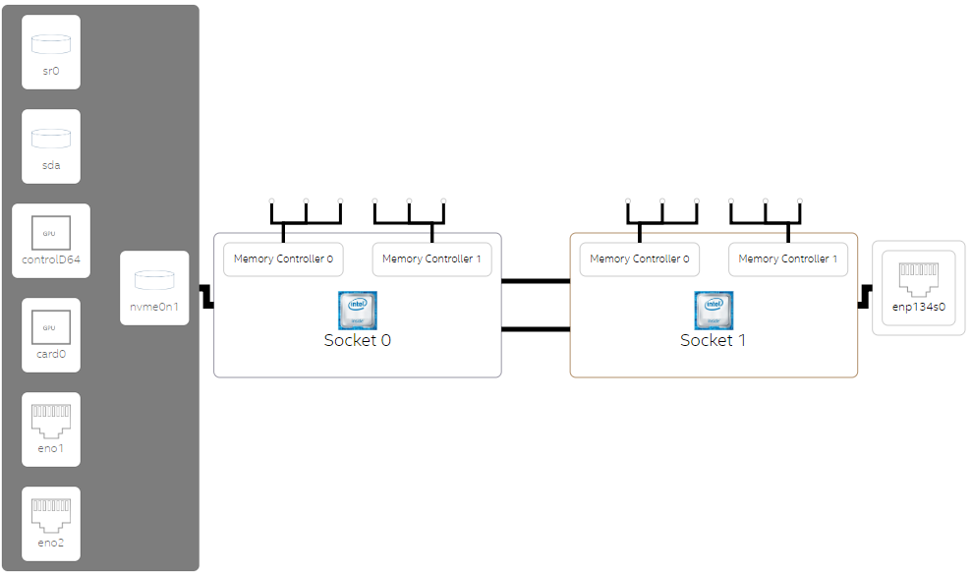
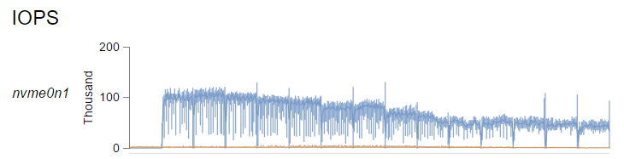
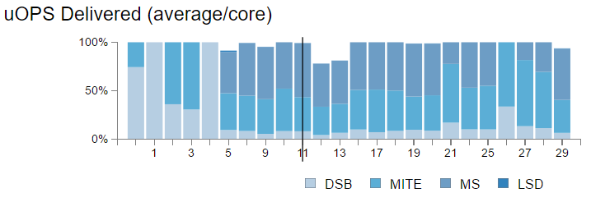
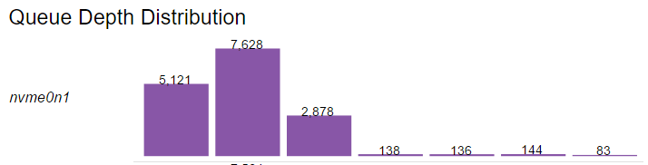
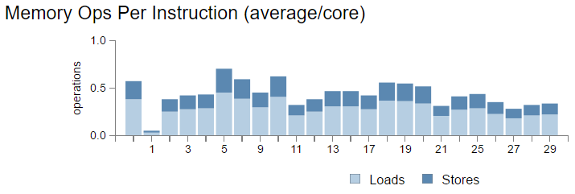
Platform Profiler
Identify system configuration issues
Intel® VTune Amplifier -
Interactive Topology Diagrams
  System configuration
  Dynamic annotations to highlight imbalances (future)
Interactive Performance metrics
  Low overhead (targeting < 1%) – coarse grain
  Sampling OS and HW performance counters
  Extended capture (min. to hours)
  RESTful API for easy analysis by scripts
  Single system (today), cloud (future)
Machine View
Timelines and Histograms
Core to Core Comparisons

Slide 9
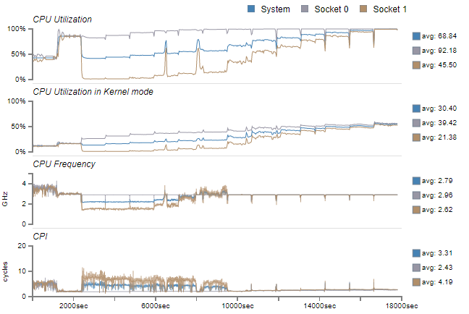
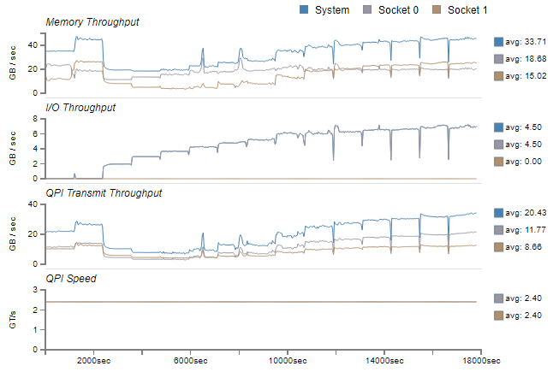
Intel® VTune Amplifier -
Platform Profiler
Identify system usage imbalances
CPU Utilization, Turbo, Cycle Efficiency
Interconnect and Bus Throughput

Slide 10
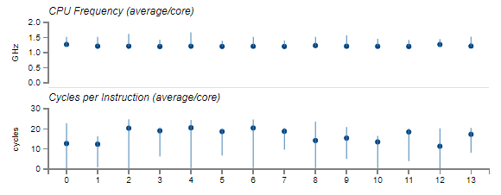
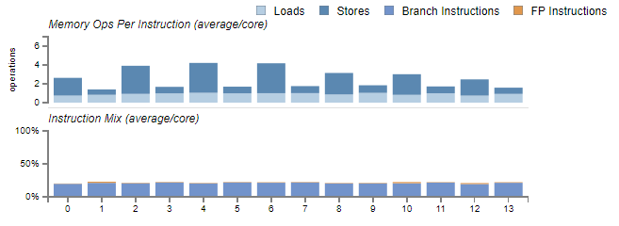
Intel® VTune Amplifier -
Platform Profiler
Identify Core-to-Core level usage imbalances
Efficiency comparisons
Workload differences

Slide 11
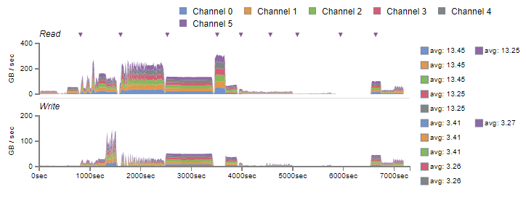
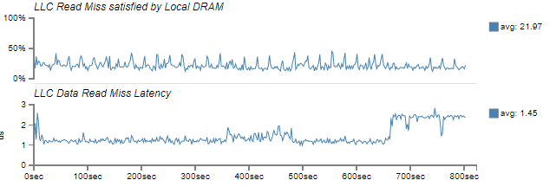
Intel® VTune Amplifier -
Platform Profiler
Identify Memory usage imbalances
Traffic Patterns
NUMA and Latencies

Slide 12
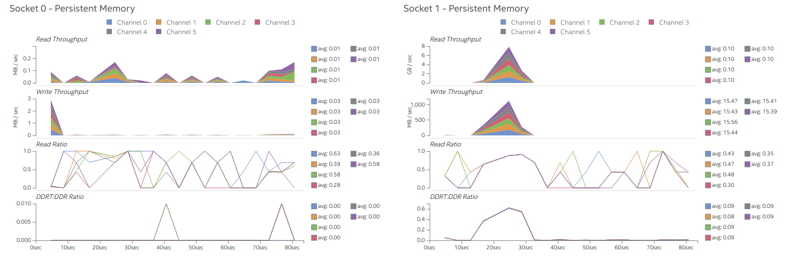
Intel® VTune Amplifier -
Platform Profiler
Investigate high-level Persistent Memory traffic

Slide 13
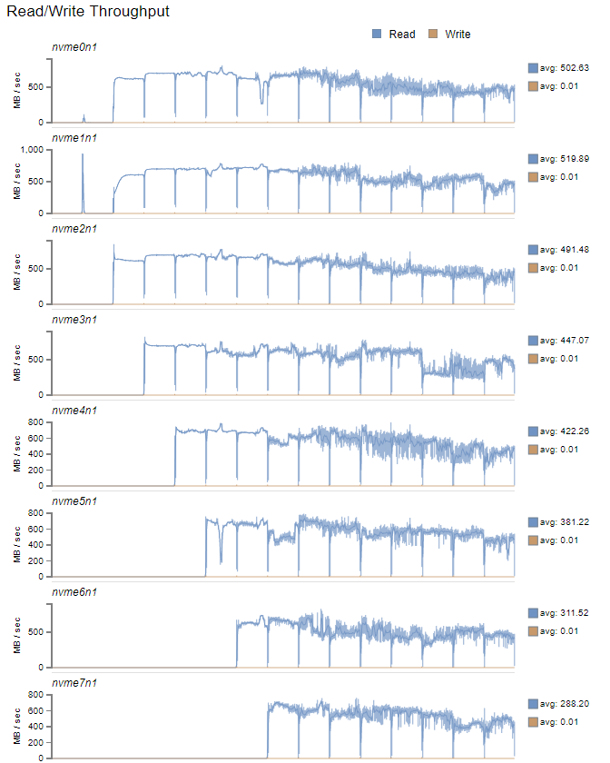
Intel® VTune Amplifier -
Platform Profiler
Identify disk utilization imbalances
Traffic Patterns

Slide 14
Main components (and terminology)
Data Collector
  Collects system-level HW and OS performance counters, computes metrics
  Stores collected data in human-readable data files (mostly CSV)
Platform Profiler Server
  Post-processes collected data into a time-series database, correlates with system topology information
  Serves data to HTTP-based clients using a simple RESTful API
Web-based user interface
  “Progressive disclosure” of performance information
  Interactive topology diagrams annotated with performance data
  Interactive performance graphs with zoom/pan functionality

Slide 15
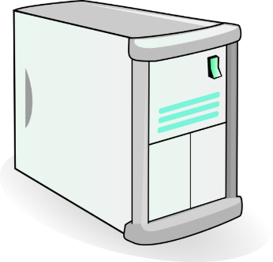
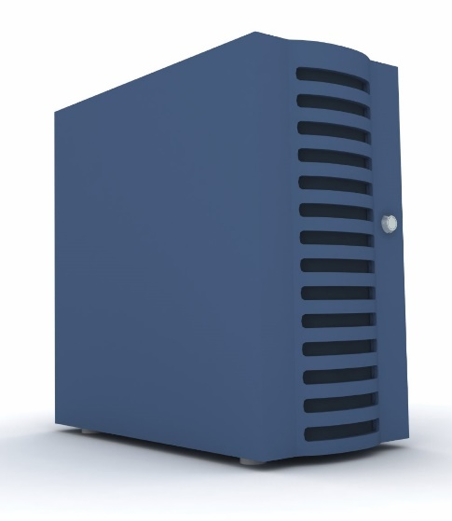


Workflow overview
Install the Platform Profiler Server*
(does not have to be on the same machine)
*Supported OSes: Ubuntu, CentOS/RHEL, Windows.
SUSE is WIP.
2. Install VTune Amplifier 2019 on “targets”
(Linux or Windows)
Ivybridge or Later
3. Collect data
4. Upload data
5. View and analyze results
HTTP
HTTP
Platform Profiler Server
Referred as: my-vppserver.intel.com
Web-based UI
Chrome works best
Data Collection “Targets”

Slide 16
Installation
Intel® VTune™ Platform Profiler is shipped with Intel® VTune™ Amplifier.
By default, the install directories are as follows
On Linux:
/opt/intel/vtune_amplifier/vpp
On Windows:
C:\Program Files (x86)\IntelSWTools\VTune Amplifier 2019\vpp

Slide 17
Collect the profiles

Slide 18
Quick-usage primer
Start a collection
source /opt/intel/vtune_amplifier/vpp/collector/vpp-collect-vars.sh
vpp-collect-start
Stop a collection
vpp-collect-stop

Slide 19
Collecting data (Linux and Windows)
Pick a workload
Set up the environment
  Linux: source /opt/intel/vtune_amplifier/vpp/collector/vpp-collect-vars.sh
  Windows: C:\<path_to_vpp>\vpp-collect-vars.cmd
Start data collection
  vpp-collect-start [-c “workload description – free text comment”]
Optional - add timeline markers (as little or as much as you want)
  vpp-collect-mark [“an optional label/text/comment”]
Stop data collection
  vpp-collect-stop
Collection results are available in a compressed file in the current directory
(<machine-name>_<datetime>.tgz/zip)

Slide 20
Upload the profiles

Slide 21
Workflow overview
2. Install data collector on “targets”
1. Install the Platform Profiler Server
3. Collect data
4. Upload data
5. View and analyze results
HTTP
HTTP
Platform Profiler Server
Web-based UI
Data Collection “Targets”

Slide 22
Uploading data using command line
From the “target” machine on which data was collected:
  vpp-collect-upload [-d target-directory] <collection results>
  Example:
  vpp-collect-upload sles12sp3_20181210-1329.tar.gz
  Please enter server name (): <my-vppserver>.intel.com<Enter>
  Please enter server port (6543): <Enter>
Notes:
Collector defaults stored here:
~/vpp_collector_config/upload_defaults

Slide 23
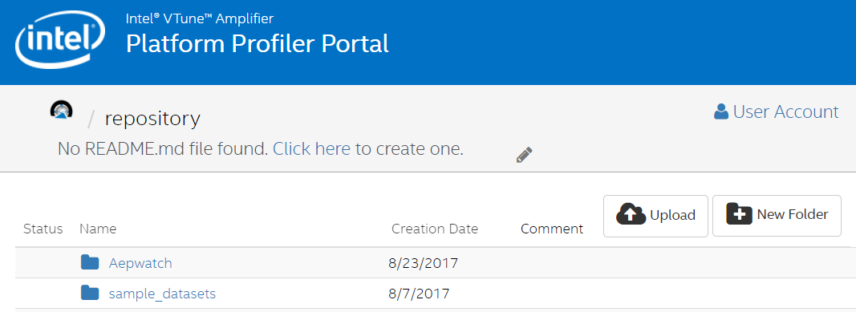
Uploading data using web interface
VTune Platform Profiler server can be started from VTune Amplifier itself.
From any machine that has access to the Platform Profiler Server:
  Point your browser to the server, e.g. http://<my-vppserver>.intel.com:6543
  Click Upload at the top-right corner and select the file to upload:

Slide 24
View the results

Slide 25
Workflow overview
2. Install data collector on “targets”
Install the Platform Profiler Server
3. Collect data
4. Upload data
5. View and analyze results
HTTP
HTTP
Platform Profiler Server
Web-based UI
Data Collection “Targets”

Slide 26
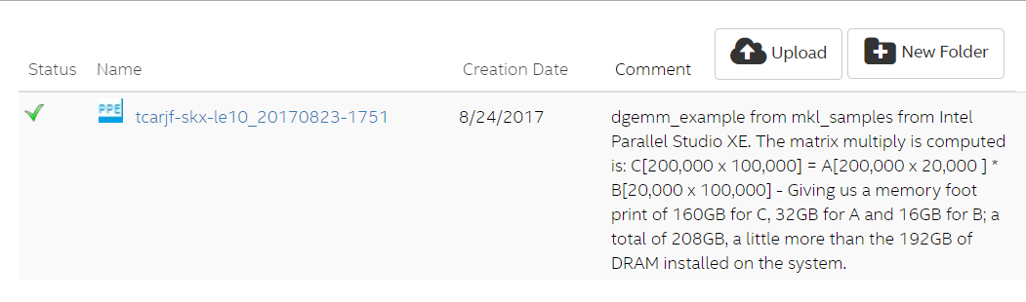
Viewing and analyzing results
From any machine that has access to the Platform Profiler Server:
  Point your browser to the server, e.g. http://<my-vppserver>.intel.com:6543
  Select the results you want to view:

Slide 27
navigate the results

Slide 28
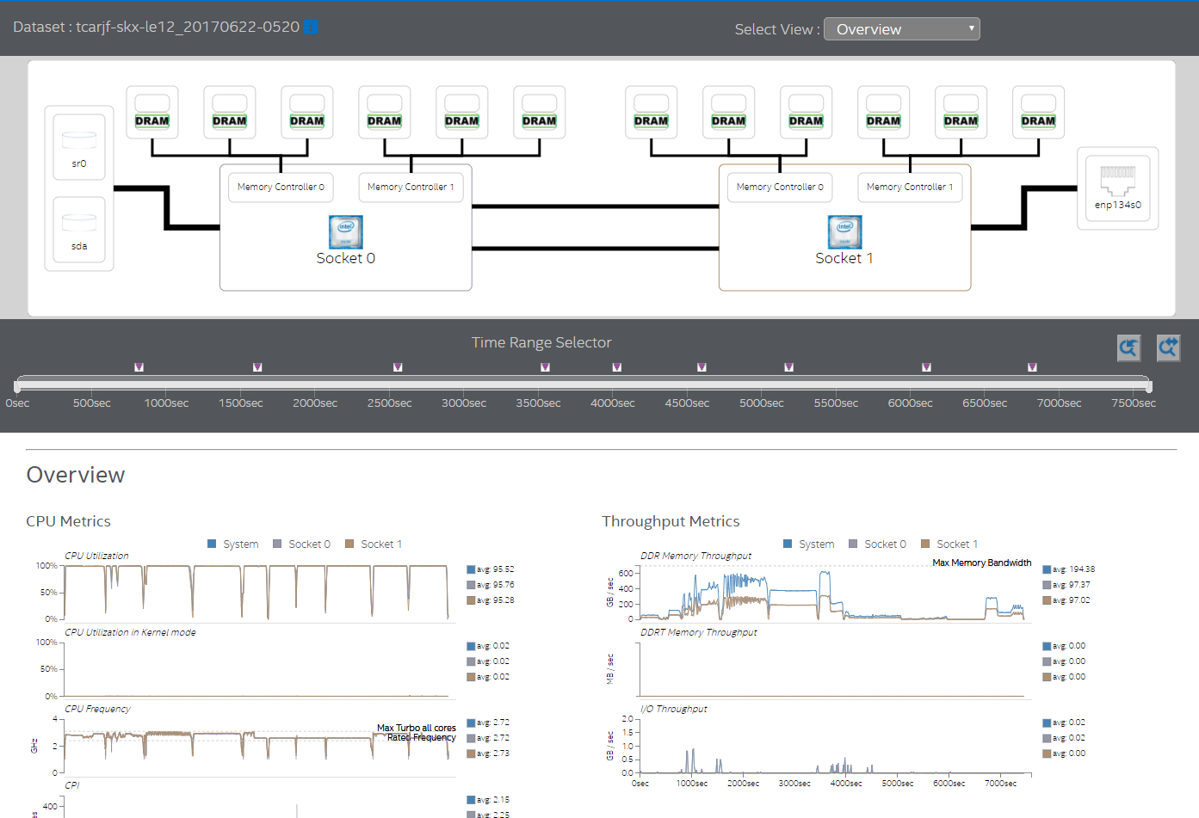
Navigation – changes view
Name of data set
Hover for details
Topology – Click through for deeper dive and to change view
Timeline of profile
Timeline markers from
vpp-collect-mark
Detailed performance data
Average for selected time range

Slide 29
Explanation of Views

Slide 30
Overview i.e. Opening View –
How is the system behaving?
CPU (System Level) Metrics
  Utilization
  Frequency
  Power (Watts and C-State)
  CPI
Interconnect Metrics
  Memory Throughput
    DRAM and Intel® Optane™ DC Persistent Memory
  Socket Interconnect Throughput
  I/O Throughput
Device Metrics
  Disk
    Throughput
    IOPS
  Network
    Send / Receive Throughput
    Infiniband - RDMA

Slide 31
Socket View -
How is this socket behaving?
Core Comparisons
  Frequency
  CPI
  Utilization
  C-State residencies
  Uop’s
  Operation Mix
    Memory Loads / Stores
    Branch vs. FP instructions
Memory
    DRAM and Intel® Optane™ DC Persistent Memory
      Throughput
      Queue Latencies
Last Level Cache
    Latency
    NUMA
Attached I/O devices
  Disk throughput/IOPS
  Queue Depth
  Response latencies (Read and Write)

Slide 32
Core View
How are the core pipelines and private caches behaving?
Core – Timeline
  Frequency
  CPI
  C-State Residencies
  uOPS
  Memory Ops
  L1 and L2 Cache Miss

Slide 33
Memory View
How is the Memory sub-system behaving?
System Level
  Memory Consumption
  Page Faults
  DRAM Power
Per Socket – Per Channel
  Memory Controller - DRAM
    Read / Write Throughput
    Read Ratio
    Read / Write Op Latency
  Memory Controller – Intel® Optane™ DC Persistent Memory
    Read / Write Throughput
    Read Ratio
    Read / Write Op Latency
  Intel® Optane™ DC Persistent Memory DIMM – Characterization
    Media Operations
    Controller Operations
    System Operations
    DIMM cache

Slide 34
Disk View
How are the attached disks behaving?
For each attached storage device
  Read / Write Throughput
  Read / Write Operation Latency
  Operation Mix
  IOPS
  Queue Depth
    Timeline
    Distribution
  Read / Write Block Size
    Timeline
    Distribution

Slide 35
I/O and Interconnect (QPI/UPI) Views
How are the interconnects behaving?
Socket Level PCI-e
  Bandwidth
  Partial PCI Writes
  I/O Cache Misses
Network
  Ethernet
    Transmit / Receive Throughput
  Infiniband (where available)
    Overall Transmit / Receive Throughput
    RDMA Transmit / Receive Throughput
    RDMA Transmit / Receive Packet rate
UPI / QPI
  Data Transmit Throughput
  Half-width link, Transmit / Receive, utilization
  Link Sleep State (where available)

